Slide 1
Quadrature Encoders
A Quadrature encoder counts electrical pulses as slotted wheel passes through a photocell.
Measures angular position and speed.

Slide 2
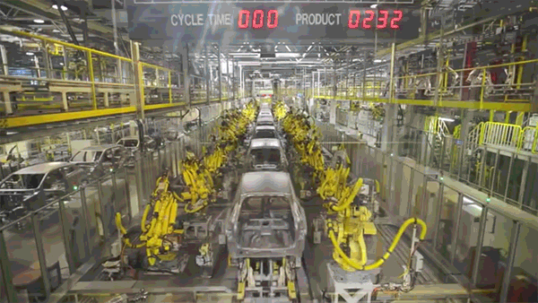
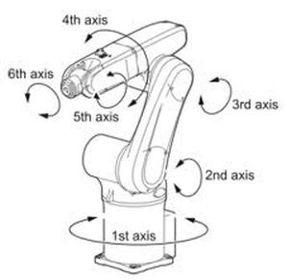
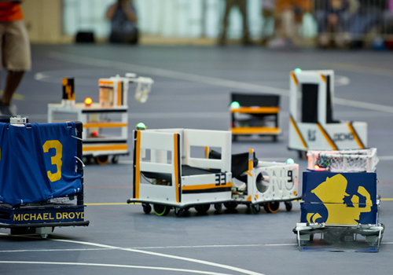
Orientation
Mechanical parts can rotate to various angles.
Robot football

Slide 3
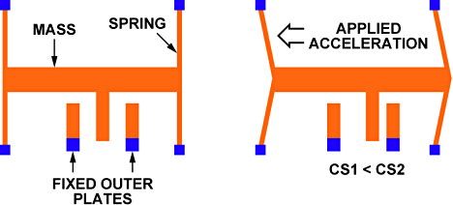
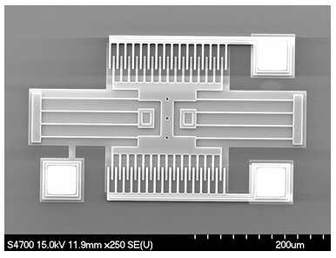
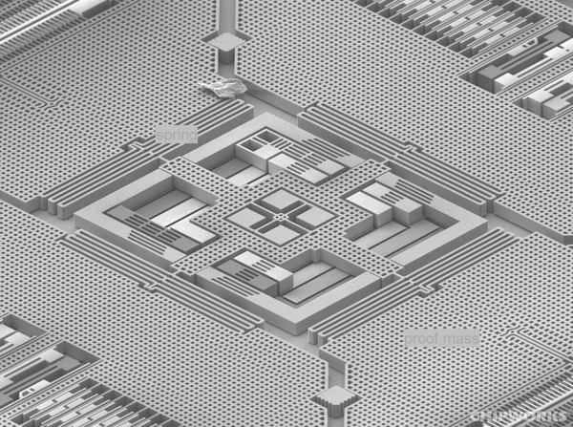
MEMS Accelerometers
Acceleration causes mass to push on spring and displace the “interdigitated” electrodes,
changes electric capacitance.
Micro-Electro-Mechanical Systems (MEMS)
3-axis gyro from an iPhone 4

Slide 4


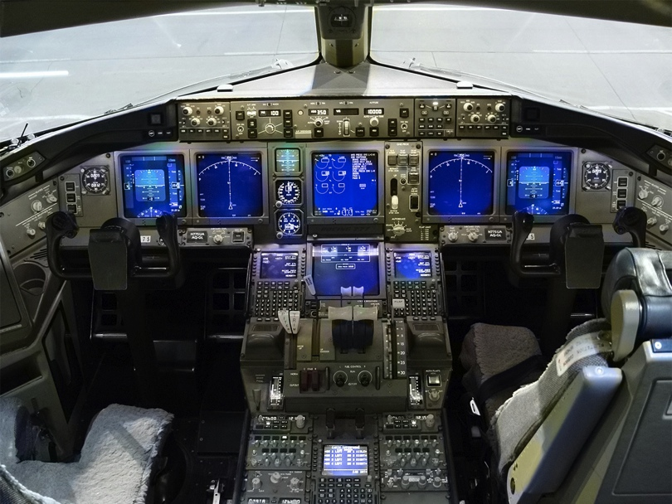
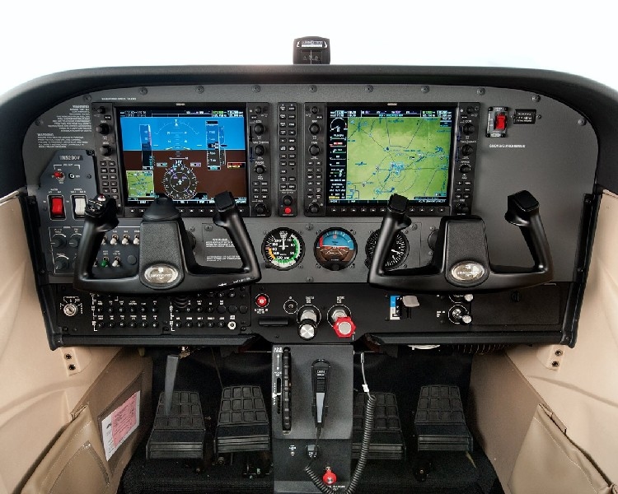
Accelerometers
Boeing 777 glass cockpit.

Slide 5
Lab1 Accelerometer Calibration
2-point calibration
At θ = 0º, a_{y} = 0, V_{OUT} = V₀
ACC
y
At θ = 90º, a_{y} = g, V_{OUT} = V₉₀
g
θ

Slide 6
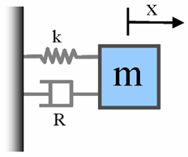
Transient Response of Sensors
2nd order response:
MEMS accelerometer, capacitive pressure sensor, piezoelectric transducers, microphones
1st order response:
Thermocouple, RTD, Thermistor
h
www.mathworks.com

Slide 7
1st Order Response
Thermocouple (TC)
“1st order response”
Response to an “impulse”

Slide 8
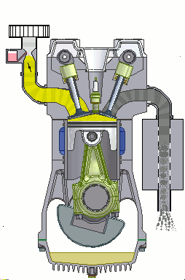
Transient Response of Sensors
Engine Speed ~ 3000 RPM ➔ T ~ 0.02 s << τ ~ 1s

Slide 9
Driven 1st Order Response
Thermocouple (TC)
“1st order response”
“Driven” response

Slide 10
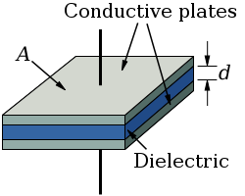
2nd Order Response
Capacitive and Piezoelectric Sensors
h
HAVE A TENDENCY TO OSCILLATE!
h
Spring mass system
Hook’s law
Accelerometer
Pressure
www.mathworks.com

Slide 11
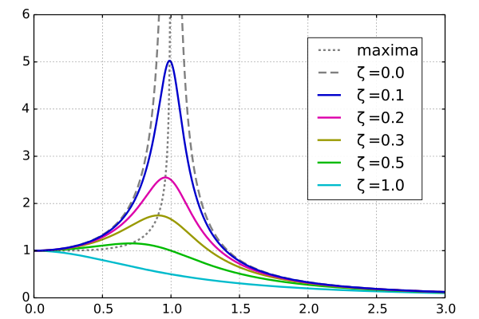
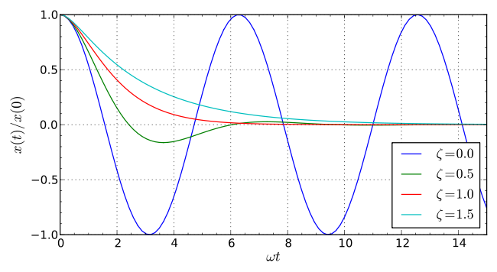
2nd Order Response
2 important parameters: resonance frequency ω₀ and damping ratio ζ
Driven response, amplitude vs. freq.
Response to an impulse
ω/ω₀
Damping ratio
ζ < 1 underdamped …ringing!
ζ = 1 critically damped …just right!
ζ > 1 overdamped …slow response!

Slide 12



2nd Order Response of Sensors
Response behavior of sensors depends on damping ratio ζ
ζ < 1 Underdamped
…Ringing! Bad for sensors!
ζ > 1 Overdamped
…Slow response! Bad for sensors!
ζ = 1 Critically damped
…Just right!
Fastest response without ringing!

Slide 13
Single pendulum: Predictable motion
Behaves as a damped harmonic oscillator.

Slide 14
Double pendulum: Chaotic motion
Motion in unpredictable and impossible to repeat.

Slide 15
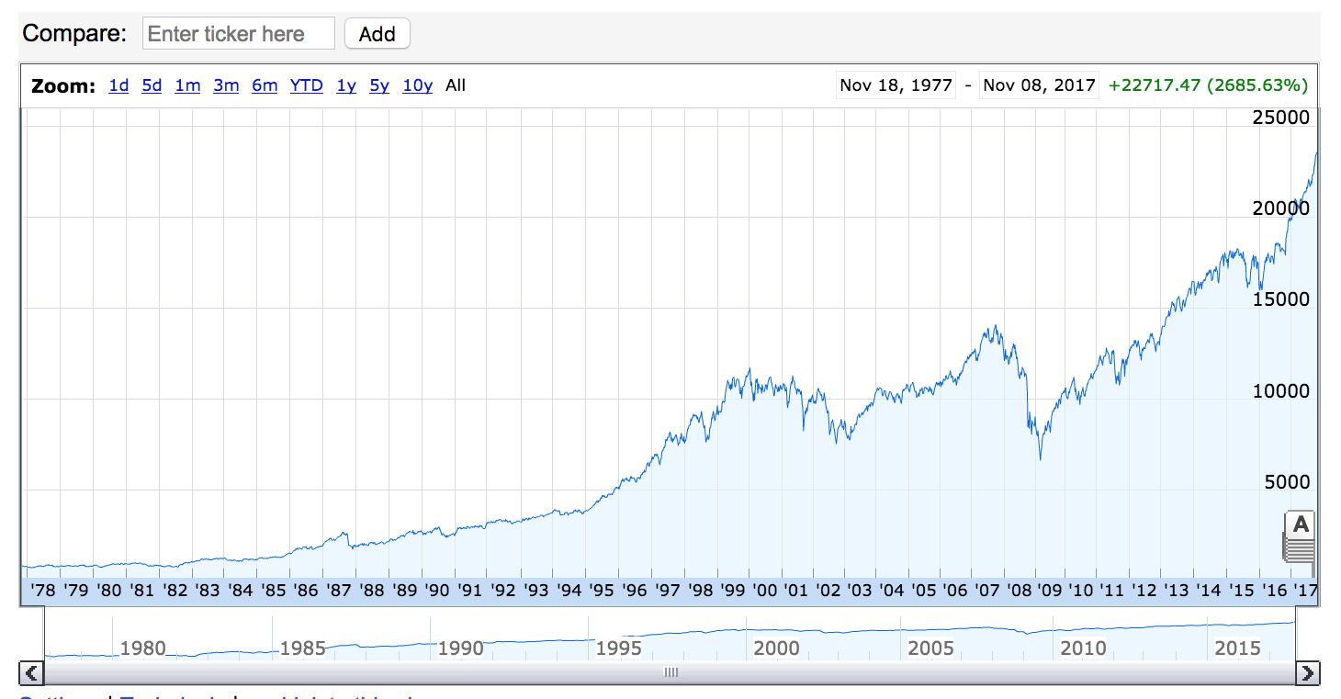
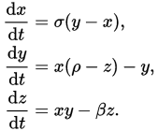
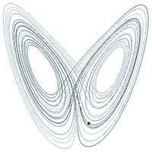
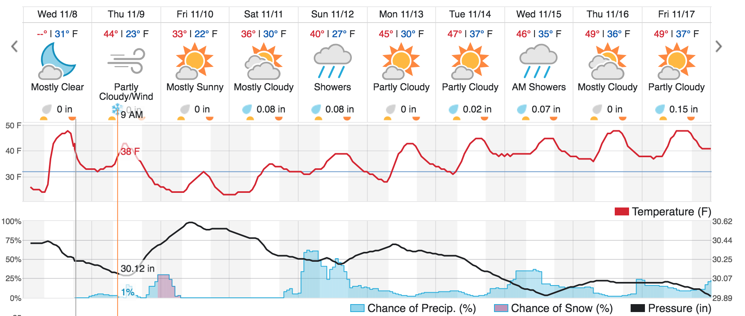
Chaos!
Complex systems are extremely sensitive to initial conditions.

Slide 16
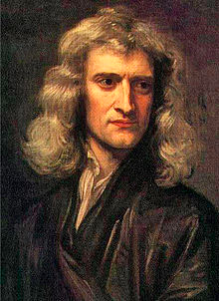
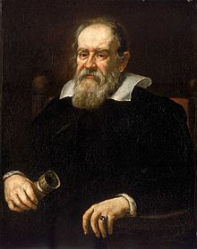
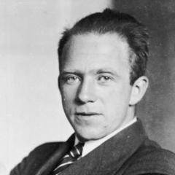
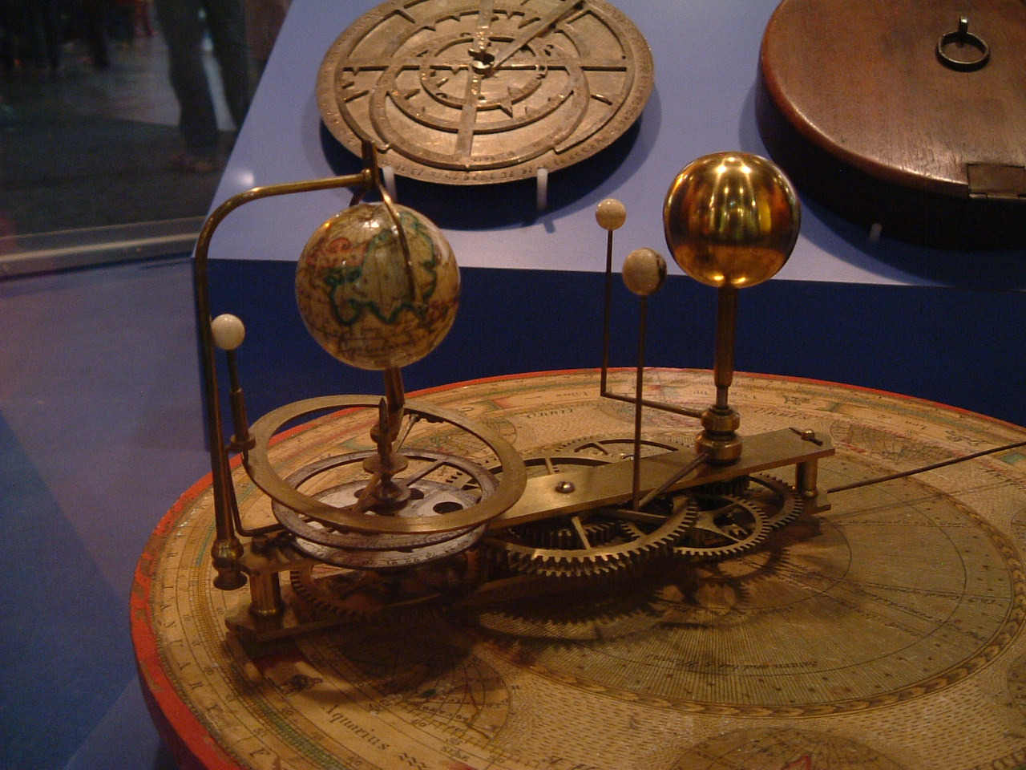

Clockwork vs. Chaos!
Thinkers of yore believed the universe behaved as “Clockwork”
Modern thinkers have embraced the unpredictability of things.

Slide 17
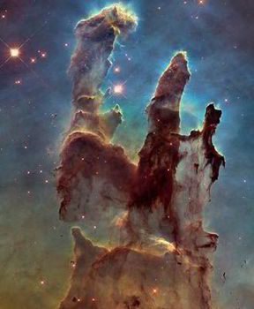
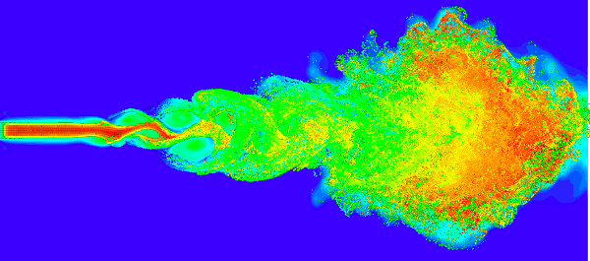

Complex Systems: Turbulence
Fluid flows often exhibit unpredictable motion known as turbulence.

Slide 18
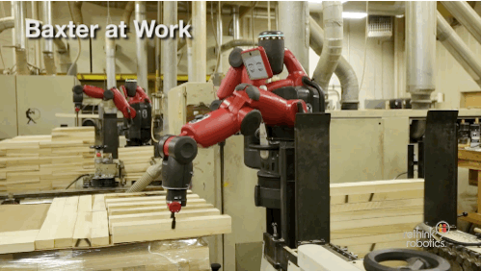
Mechanical Control
Understanding and controlling complex mechanic systems is hard!

Slide 19

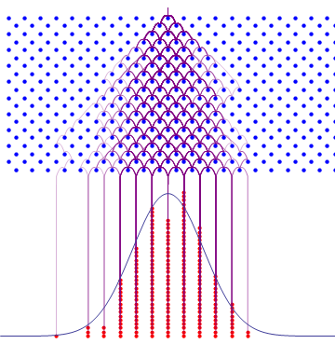
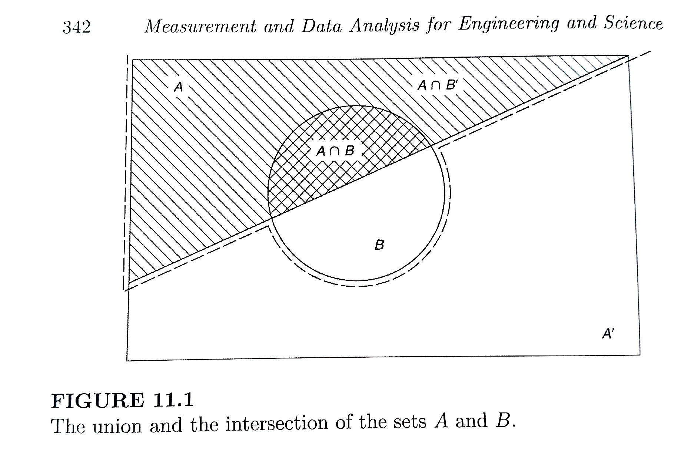
Probability and Statistics

